Slide 1
REPORT
Nguyen Ngoc Thien

Slide 2
Table of contents
01
02
Source Code
Inference Image & Video
03
Compare Performance
Translate code pyrthon to cpp
Result of detection
04
Summary

Slide 3
Source Code
01
Convert python code to cpp with function & class

Slide 4
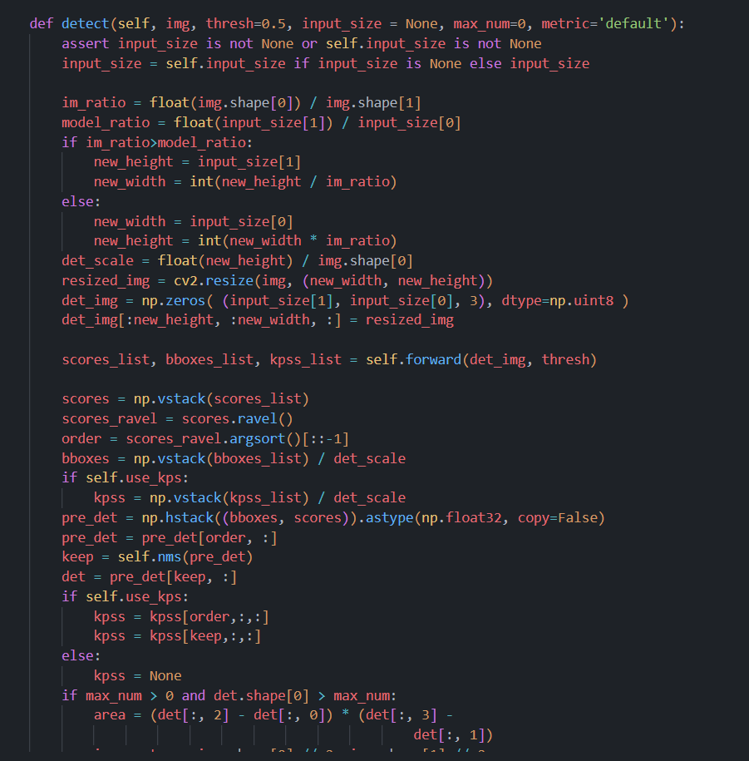
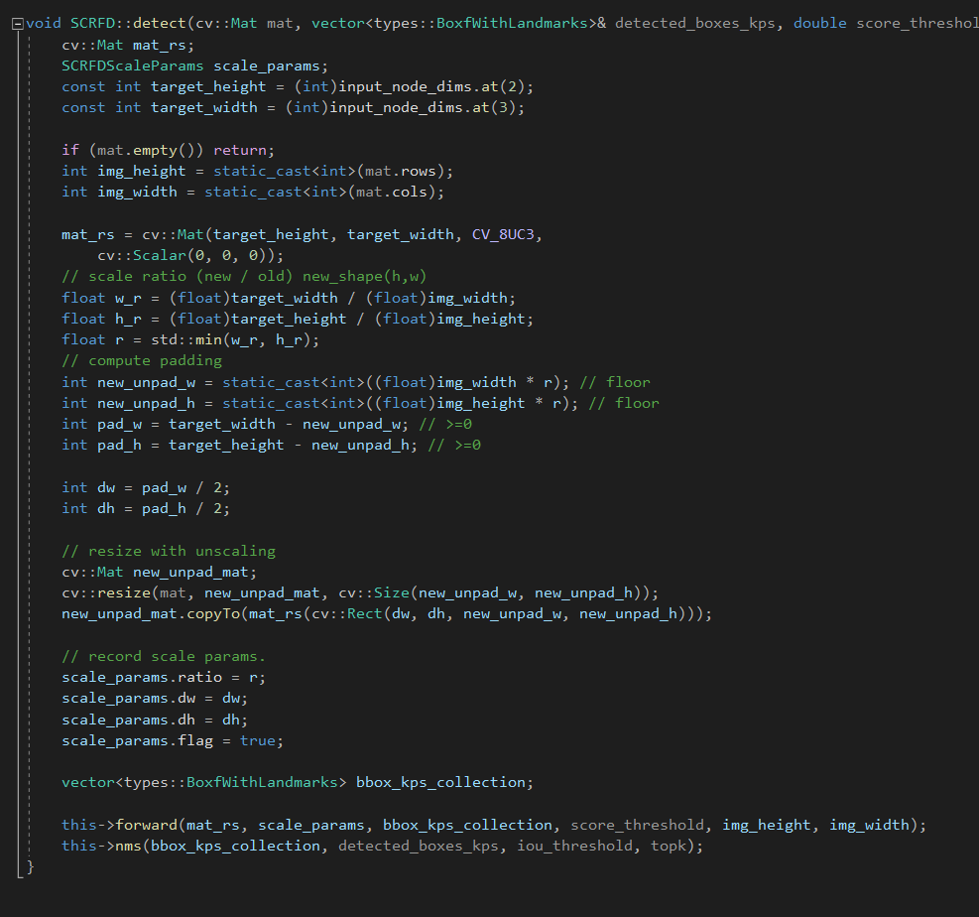
Python / CPP (Detect function)
AI-Engineer-Tests\scrfd\python\model.py
AI-Engineer-Tests\scrfd\cpp\Convert-Python-To-CPP\Convert-Python-To-CPP\scrfd.cpp

Slide 5
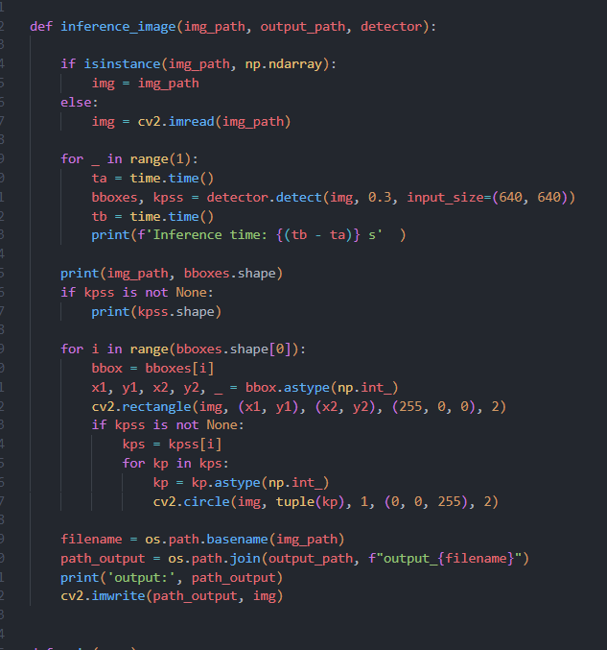
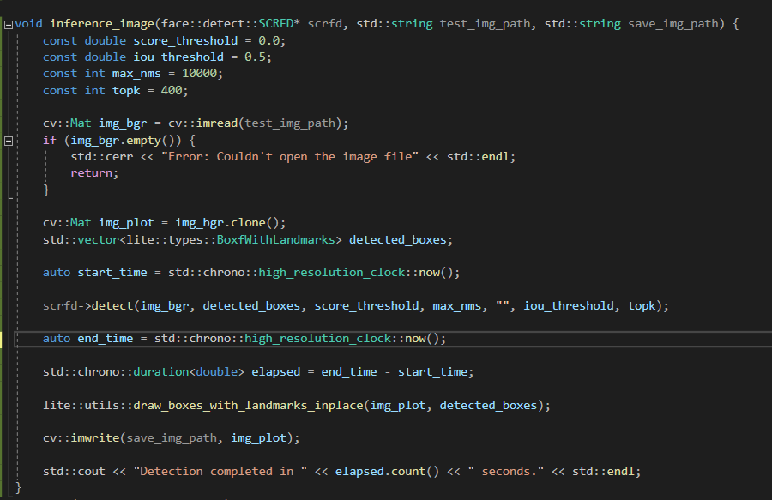
Python / CPP (Inference Image)
AI-Engineer-Tests\tests\test_scrfd_image.py
AI-Engineer-Tests\scrfd\cpp\Convert-Python-To-CPP\Convert-Python-To-CPP\main.cpp

Slide 6
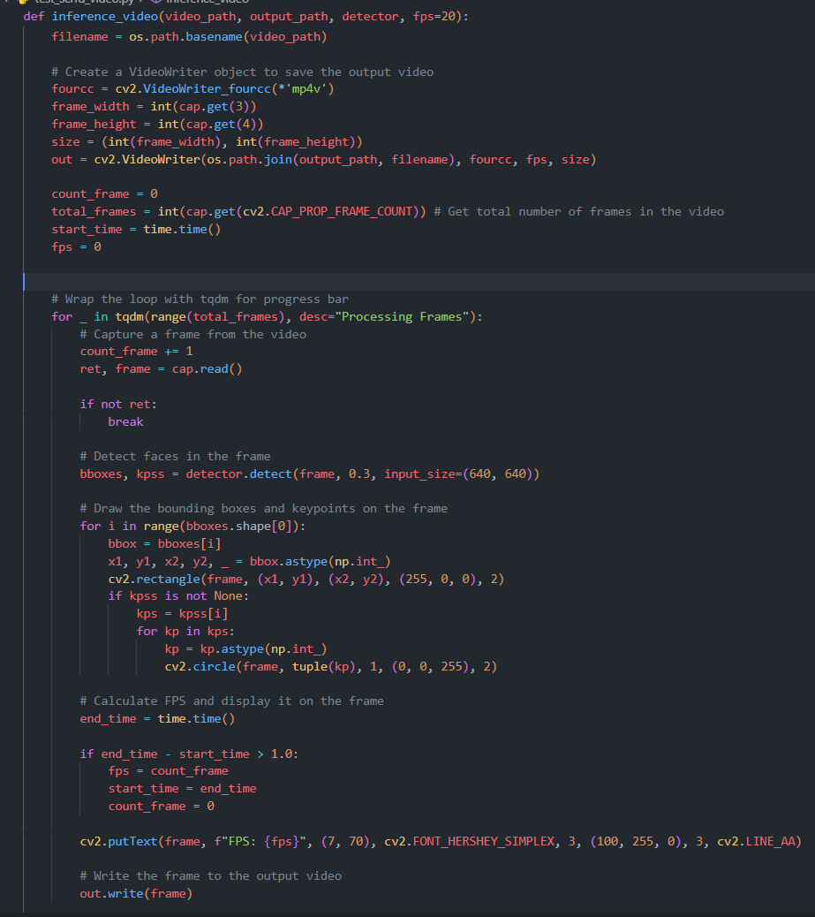
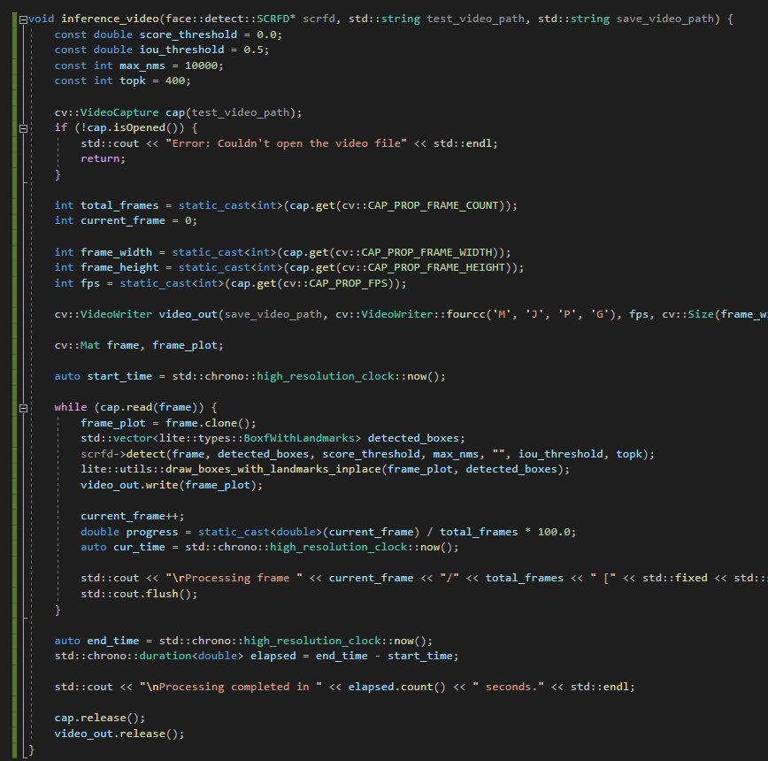
Python / CPP (Inference Video)
AI-Engineer-Tests\tests\test_scrfd_video.py
AI-Engineer-Tests\scrfd\cpp\Convert-Python-To-CPP\Convert-Python-To-CPP\main.cpp

Slide 7
Inference Image & Video
02

Slide 8
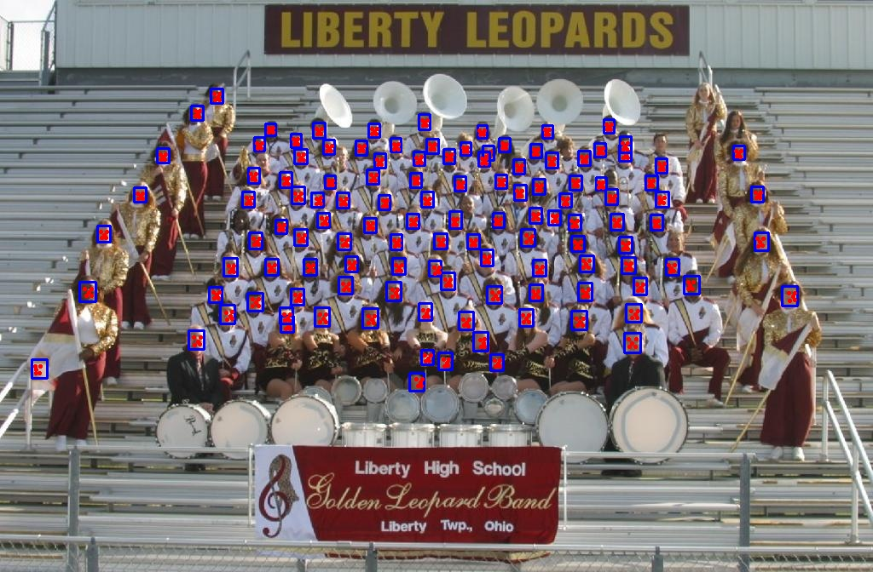
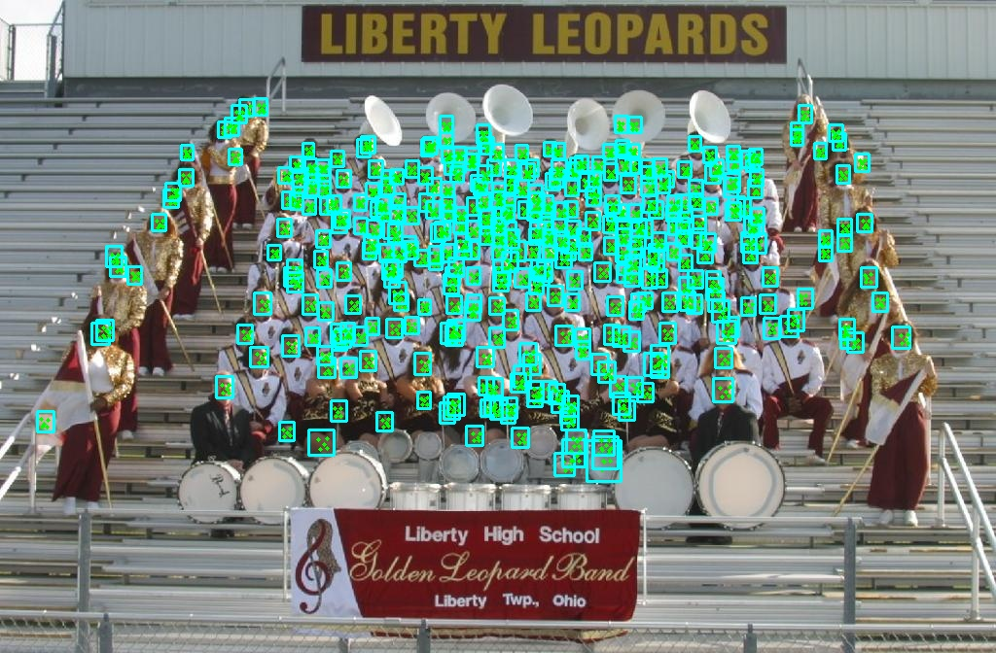
Image Result
Python
CPP
AI-Engineer-Tests\public\images\output\output_python.jpg
AI-Engineer-Tests\public\images\output\output_cpp.jpg

Slide 9
Video result
Python
CPP
AI-Engineer-Tests\public\images\videos\output_python.mp4
AI-Engineer-Tests\public\videos\output\output_cpp.jpg

Slide 10
Compare Performance
03

Slide 11
Compare table
~ | PYTHON | CPP
Speed Video | 11p38 s | 22p
Speed Image | ~0.025 s | ~0.05 s
GPU | ~0.1 GB | 0.1 GB
CPU | ~63% | ~ 14.1%
RAM | ~284 MB | ~408 MB
FPS | 28 - 32 frame / s | 14 - 19 frame / s

Slide 12
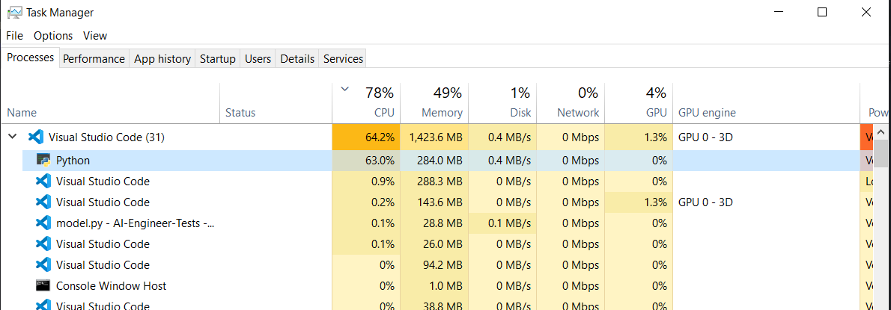
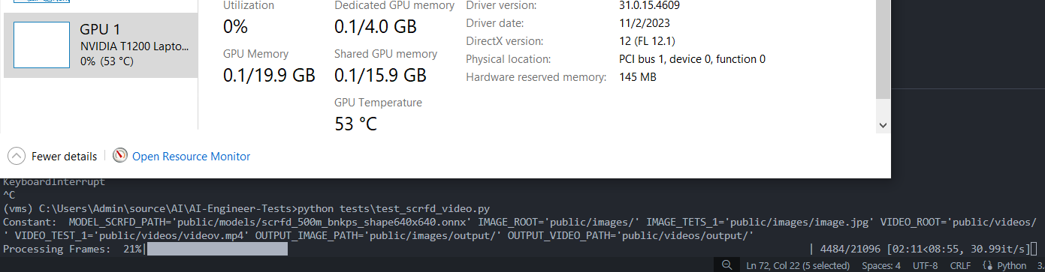
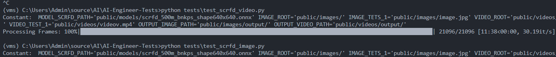
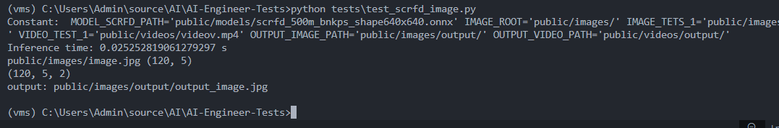
Python
CPU
RAM
GPU
Time inference video
Time inference image

Slide 13
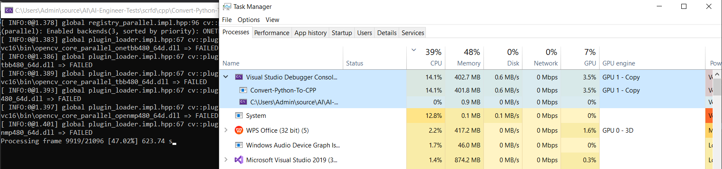
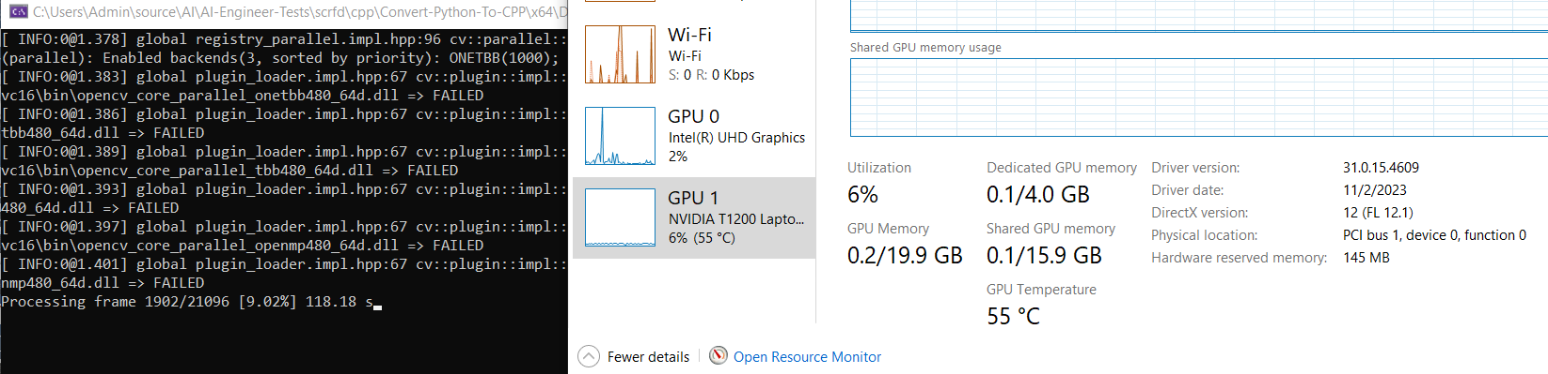
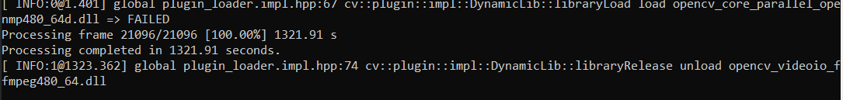
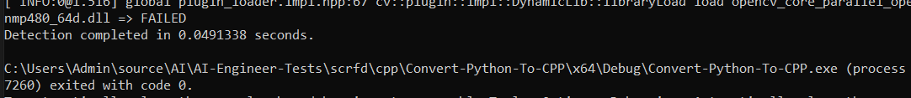
CPP
CPU
RAM
GPU
Time inference video
Time inference image

Slide 14
Summary
04

Slide 15
Summary
Đánh giá
Nhìn chung python đang có hiệu suất tốn hơn mặt dù sử dụng CPU nhiều nhưng thời gian thực thi trên GPU lại khá nhanh khoảng trung bình 30 FPS so với 16 FPS của code C++. Đánh đổi tốc độ thì code C++ lại tốn ít tài nguyên cho việc sử lý ảnh hơn.
Cấu hình
CPU: I7 11800H
RAM: 32 GB
GPU: 4GB

Slide 16
Thanks!
Do you have any questions?
Ngocthien.dev23@gmail.com
+84 365858975
https://www.linkedin.com/in/nguyen-ngoc-thien-331ab425b/
Please keep this slide for attribution

